Slide 1
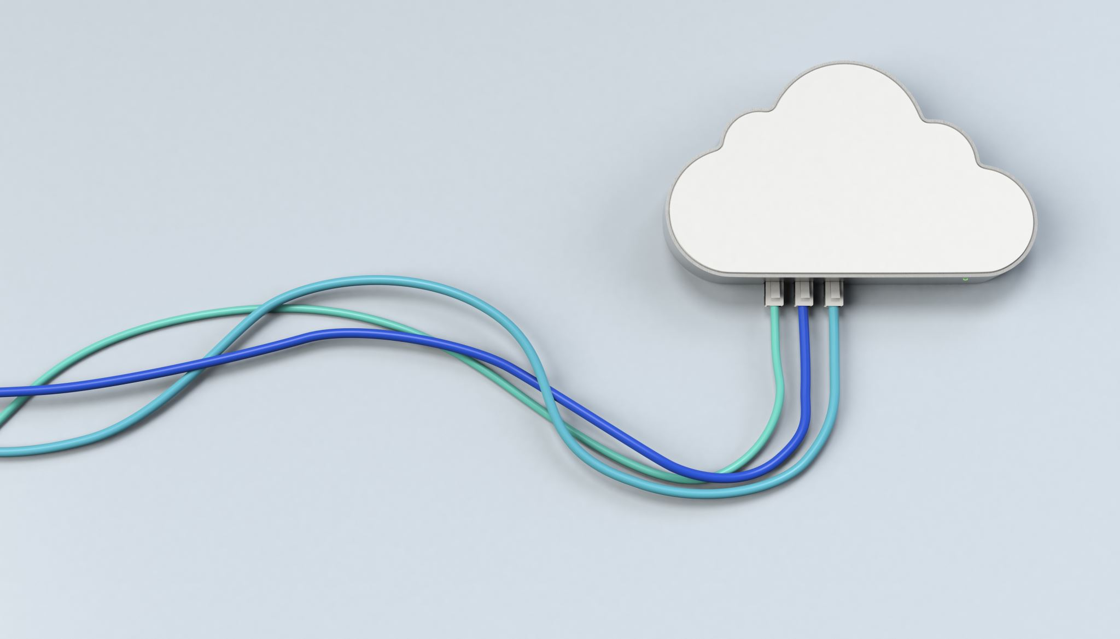
CHAPTER 3 BENEFITS & CHALLENGES
|Cloud Computing

Slide 2

ORIGIN OF THE TERM ‘CLOUD COMPUTING’
The term ‘cloud computing’ appeared in the market with its present meaning in the year 2006.

Slide 3
ORIGIN OF THE TERM ‘CLOUD COMPUTING’
Network Cloud (1990s):
In early network designs, engineers used cloud symbols in diagrams to represent unknown parts of the network.
This was called the "network cloud," but it didn’t refer to cloud computing as we know it today.
Utility Computing Initiatives:
Towards the end of the 20th century, utility computing was the focus of major software firms, aiming to deliver applications over the Internet.
Email services and platforms like Salesforce (in 1999) offered business applications over the Internet, marking early steps towards cloud-based services.

Slide 4
ORIGIN OF THE TERM ‘CLOUD COMPUTING’
Emergence of Cloud Computing (2006):
The term "cloud computing" began being used in the early 2000s by those involved in utility computing.
Official recognition came in 2006 when Google's CEO Eric Schmidt used it in a public forum.
In the same year, Amazon introduced its Elastic Compute Cloud (EC2), bringing cloud computing into the commercial market.
Etymology of the Term "Cloud":
The word "cloud" refers to something obscure or hidden.
The term likely symbolizes a collection of computing resources where the inner workings are hidden from users, offering abstracted services without revealing the complexity behind them.

Slide 5

Early Initiatives
1. Salesforce.com (1999):
Launched the first successful commercial initiative to deliver enterprise applications via a regular website.
This marked a turning point, encouraging other firms to explore cloud-based business applications.
2. Amazon Web Services (AWS) (2002):
AWS introduced computing services over the Internet, offering a suite of services including storage.
This solidified the utility computing model, pushing firms to modernize their data centers.

Slide 6
Early Initiatives
3. Elastic Compute Cloud (EC2) (2006):
Amazon launched EC2, allowing companies and individuals to rent virtual machines to run their applications.
This was the first major cloud service offering and is seen as the concrete birth of modern cloud computing.
4. Google Docs (2006):
Google introduced Google Docs, popularizing cloud services for the public by offering online document editing and collaboration.

Slide 7
Initiatives
5. Force.com (2007):
Salesforce launched Force.com, allowing users to build applications and launch websites, pushing further into cloud platforms.
6. Windows Azure (2009):
Microsoft entered the cloud computing space with Windows Azure, enabling customers to run Windows applications over the Internet.
7. NASA's Nebula (2008):
NASA launched Nebula, an open-source cloud platform for internal use, contributing to cloud research and development.
8. Data Center Modernization:
As cloud computing emerged, many firms began modernizing their data centers to support the utility computing model.

Slide 8

Utility Computing
Definition of Utility Computing:
A vendor provides and maintains computing resources, delivering them to subscribers on-demand.
Subscribers pay based on usage, either through fixed rental or actual use-based billing models.
Key Features of Utility Computing:
On-Demand Service: Subscribers access the required computing facilities as needed.
Metered Service: Usage is metered, and charges are based on consumption.
Cost Reduction: Sharing resources among many subscribers leads to reduced computing costs.
Billing Models:
Fixed Rental: Subscribers pay a fixed amount for a set period, typically monthly.
Actual Use-Based: Billing depends on the actual service usage by the subscriber.

Slide 9

Utility Computing
Benefits for Subscribers:
Cost Efficiency: Reduced IT operational costs by outsourcing computing facilities.
Flexible Investment: Shifts from large upfront investments to smaller, variable payments.
Access to Expertise: Avoids the need for in-house expertise, leveraging the provider's specialized knowledge.
Benefits for Providers:
Return on Investment (ROI): Providers can serve many users with the same infrastructure, maximizing ROI.
Scalability: The utility model enables scalability, offering services in varying volumes based on demand.

Slide 10

Utility Computing
Comparison to Traditional Models:
In the past, organizations maintained their own data centers or outsourced computing within their premises, incurring higher costs.
The cloud computing model represents a shift, offering outsourced computing resources in a more flexible and cost-effective form.
Notable Utility Computing Initiatives:
IBM, HP, and Sun Microsystems led utility computing research towards the end of the 20th century.
Later, companies like Microsoft, Google, and Amazon joined the market with cloud-based solutions.
Overall Advantages:
Low Initial Investment: The utility model allows subscribers to access computing power without heavy upfront costs.
Operational Savings: Outsourcing to reputable providers ensures expertise and reduces the complexity of maintaining IT operations.

Slide 11
METERING AND BILLING IN CLOUD
Accurate Metering in Cloud Computing:
Cloud computing enables precise measurement of service usage, which wasn't fully possible in earlier models like cluster computing.
Technological Advancements:
Cloud computing incorporates technologies that support the accurate measurement of resource consumption, allowing for real-time tracking of usage.
In traditional computing, the basic metering functions were not adequate for measuring the actual use of computing. Cloud computing is empowered with this facility

Slide 12
METERING AND BILLING IN CLOUD
Types of Metered Resources:
Processing Power: Subscribers are billed based on CPU and memory usage.
Storage: Costs are based on the actual volume of data stored.
Network Bandwidth: Charges apply according to the bandwidth consumed over time.
Billing Model:
Subscribers are billed based on actual usage of computing resources such as processing, storage, and bandwidth, ensuring they only pay for what they use.
Cost Savings:
Precise metering results in more efficient cost management for users, avoiding overpayment for unused resources.
Advantage Over Traditional Systems:
Traditional models lacked the ability to accurately meter resource usage, whereas cloud computing provides detailed, transparent metering of each resource type.

Slide 13
SEPARATION OF DATA CENTER OPERATION
Burden of Data Center Operations:
Enterprises traditionally handled infrastructure setup, electricity, cooling, system maintenance, upgrades, and security, which was a significant burden.
Traditional Model:
In the traditional computing model, managing data centers was often outsourced to specialists to ease the load on internal teams.
Cloud Computing Separation:
Cloud computing fully separates data center operations from the user’s computing tasks, allowing users to focus solely on application development and usage.

Slide 14
SEPARATION OF DATA CENTER OPERATION
Data Centers in Cloud Computing:
The data centers are remotely located and managed by cloud service providers, who handle all operational tasks such as maintenance, security, upgrades, and power supply.
Relief for Users:
This separation relieves users from the complexities of infrastructure management, allowing them to concentrate on their core tasks like software development and business operations.
Vendor Responsibilities:
Cloud vendors are responsible for the entire management of the data center infrastructure, including recovery, protection from attacks, and resource scalability.

Slide 15
BENEFITS OF CLOUD COMPUTING
Less Acquisition/Purchase Cost:
Cloud computing reduces the initial capital investment by eliminating the need for purchasing extensive hardware or software resources upfront.
Reduced Operational Cost:
Operational costs like system maintenance, administration, and energy support are shifted to cloud providers, significantly reducing the user’s financial burden.
Reduced System Management Responsibility:
System management tasks such as updates, recovery, and security are handled by the cloud vendor, freeing the user from these responsibilities.
Use-basis Payment Facility:
Cloud users are billed based on actual consumption, making it more cost-effective and flexible compared to fixed costs.
Unlimited Computing Power and Storage:
Users can access scalable computing power and virtually unlimited storage, making it accessible even for smaller businesses.

Slide 16
BENEFITS OF CLOUD COMPUTING
Quality of Service (QoS):
Renowned cloud vendors provide reliable, high-quality service, ensuring consistent performance.
Reliability:
Cloud vendors handle critical functions like load balancing, backups, and recovery, making the service more reliable than traditional setups.
Continuous Availability:
Cloud services offer high uptime (99.9%), ensuring near 24/7 availability for users.
Locational Independence:
Users can access cloud services from anywhere with an internet connection, providing flexibility and convenience.
High Resiliency:
Cloud infrastructures are resilient to attacks and disruptions due to redundancy and other protective measures.

Slide 17
BENEFITS OF CLOUD COMPUTING
Quick Deployment:
Cloud computing allows rapid deployment of applications and services, giving businesses a competitive edge.
Automatic Software Updates:
Software updates are automatic, ensuring users always have the latest version without manual intervention.
No License Procurement:
Users pay for software as they use it, eliminating the need for long-term software licensing agreements.
Safety against Disaster:
Cloud services have robust recovery systems, ensuring data and systems are better protected against disasters.
Environment Friendly:
Cloud computing minimizes resource usage and reduces e-waste, contributing to a lower carbon footprint.

Slide 18
CHALLENGES OF CLOUD COMPUTING
Limited Portability between Cloud Providers:
Proprietary cloud platforms make it difficult to move applications between different cloud providers due to vendor lock-in, limiting portability.
Interoperability Problem:
Proprietary standards restrict applications from different cloud vendors from working together, creating interoperability issues when using multiple cloud platforms.
Data Security:
Storing data outside a user’s network boundary introduces vulnerabilities, as security is largely dependent on the cloud vendor.
Reduced Control over Governance:
Cloud users have limited control over the governance and operational policies of the cloud, which is managed by the vendor.
Multi-Regional Compliance and Legal Issues:
Legal and privacy concerns arise when data is stored in different geographical regions, as laws vary across jurisdictions regarding data disclosure and compliance.
Bandwidth Cost:
While cloud services reduce overall costs, the additional expense of network bandwidth, especially for data-intensive applications, can increase total costs.

Slide 19
How Cloud Computing Addresses Business Challenges
Cloud computing addresses business challenges by offering:
Flexibility: Provides scalable and adaptable computing environments.
Cost Efficiency: Reduces initial capital expenditures and operational costs.
Resource Management: Outsources infrastructure management to vendors, reducing the burden on businesses.

Slide 20
Ethical Issues in Cloud Computing
Accountability: Issues arise from the blurred lines of responsibility between cloud vendors and users.
Data Security: Cloud vendors must ensure robust protection of sensitive data.
Intellectual Property: Cloud vendors need to handle intellectual property responsibly.

Slide 21
Cloud Computing: Network as Computer
Concept: Cloud computing can be seen as a vast network of computers that users view as a single entity.
Philosophy: Reflects Sun Microsystems' slogan, "The network is the computer," combining computing power from multiple systems.

Slide 22
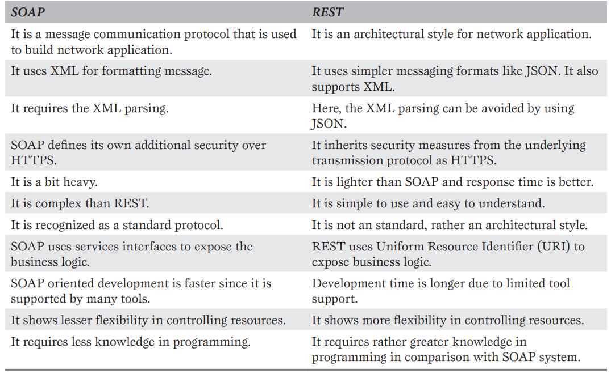
Role of Web Services
Definition: Web services enable communication between software systems over a network, using standardized methods.
Categories:
SOAP (Simple Object Access Protocol): A protocol for exchanging structured information.
REST (Representational State Transfer): An architectural style for designing networked applications.

Slide 23

Role of APIs
Definition: APIs (Application Program Interfaces) provide a standard way for software components to interact.
Types:
IaaS APIs: For resource configuration and management.
PaaS APIs: For integrating with platform services.
SaaS APIs: For integrating with software applications.
Function: APIs facilitate access to cloud services and ensure compliance.

Slide 24
Ubiquitous Cloud
Definition: Ubiquitous computing refers to making computing available everywhere, often through smart devices.
Role of Cloud Computing: Enhances the concept of ubiquitous computing by providing resources from anywhere at any time.

Slide 25
Confusion Between Cloud and Internet
Difference: While cloud computing is delivered via the Internet, it is distinct from traditional web access.
Characteristics: Cloud computing offers utility-based, scalable, and measurable computing services beyond static or dynamic web content.
Cloud and Internet are not same.
Internet is a means for accessing cloud.

